Slide 1


International Conference On Current Trends In Science, Engineering And Technology Paper Id- 886 ON-TIME : The Idea For Text And Post Automation
Dept. Of AIML and Dept. Of ISE
H Vaishnavi, 3rd Sem - Aiml
Dr. Sandhya N, HOD - Aiml

Slide 2
INTRODUCTION
Forgetting to wish our people.
Many events - we tend to forget to upload posts.
Submit our projects on particular time the boss/lecturer has assigned.
Or let's say, to maintain the streaks in snap.
Transfer money on the set time through our app.

Slide 3
About the APPLICATION
Many of us have this problem of forgetting to wish our people on some particular dates or time / send files or documents /upload anything on particular time etc.
This app is helpful for those who belong to this category, to everyone, in fact, to save time.
Our app basically connects all the social medias in one application. Lets understand about this app in detail.

Slide 4
Lets see the outlook of the application we have prepared:
ON TIME wrt WhatsApp

Slide 5
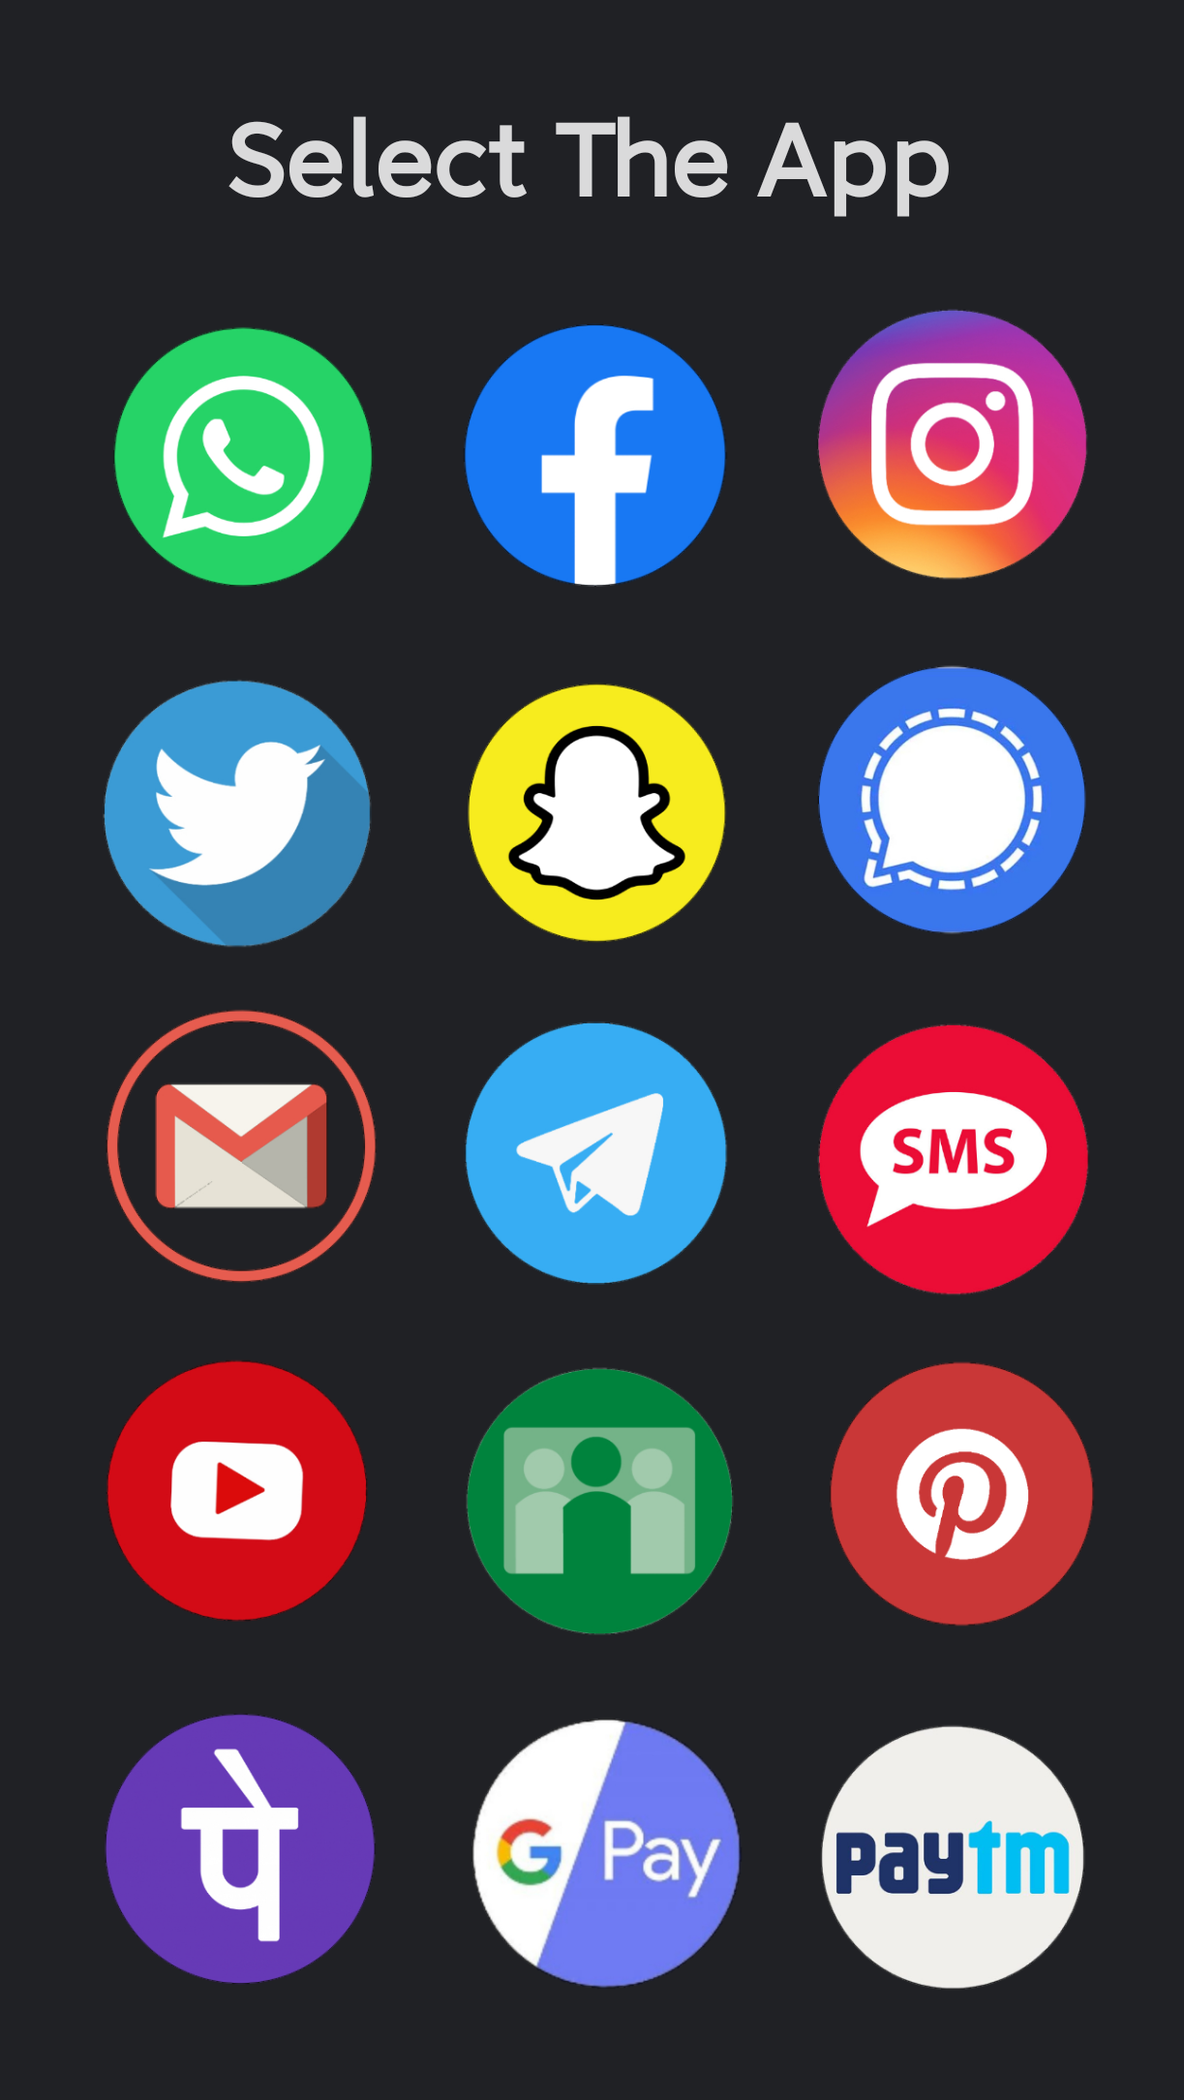
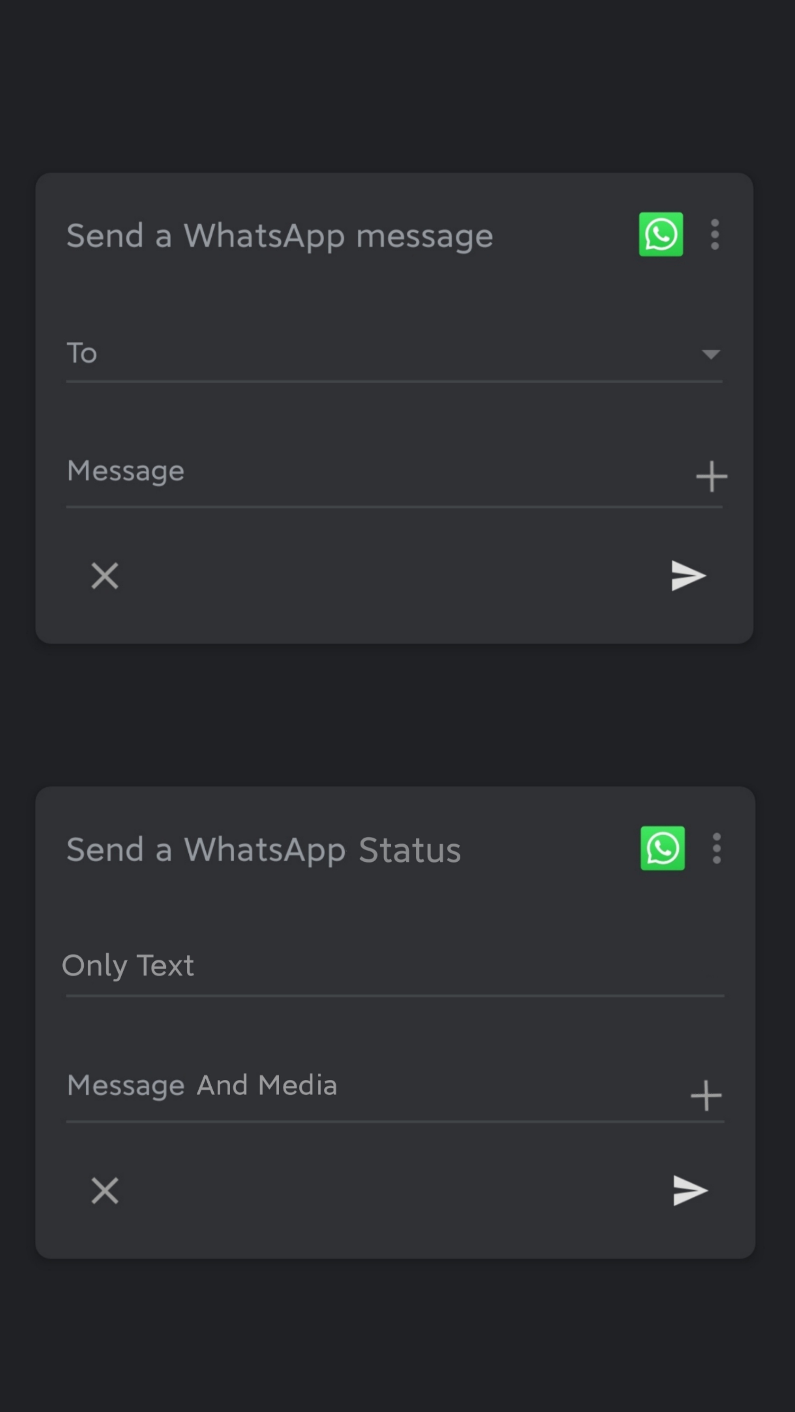


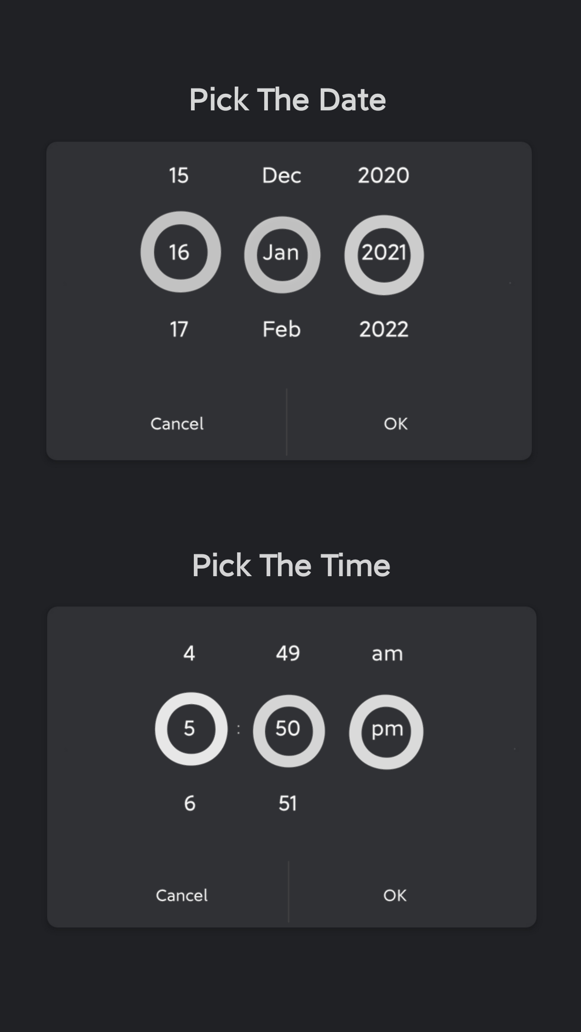

Slide 6
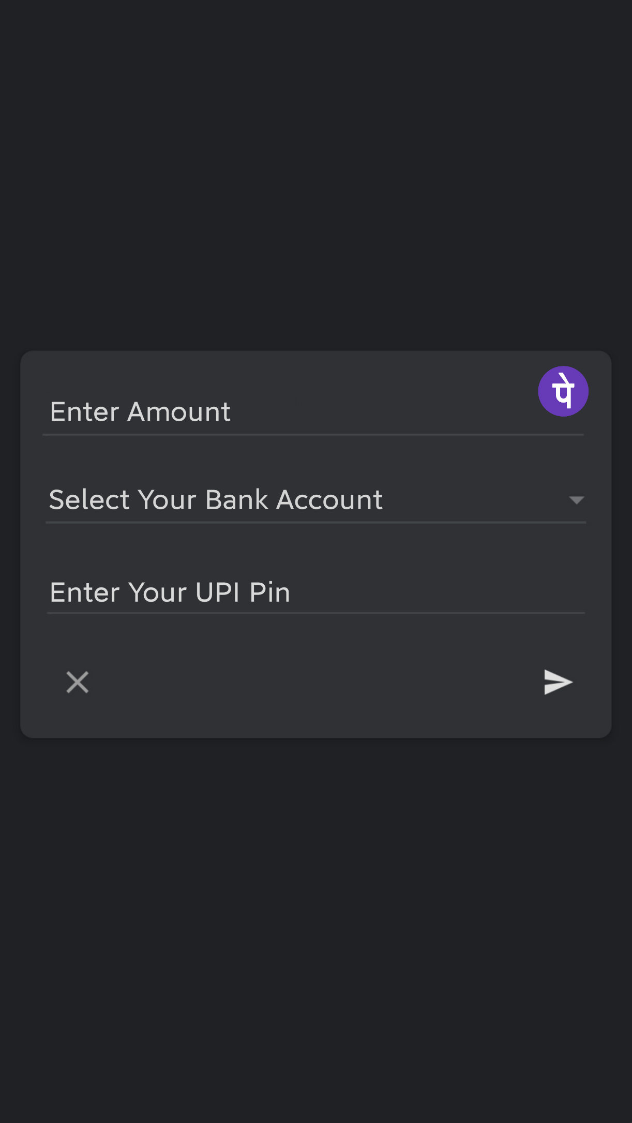




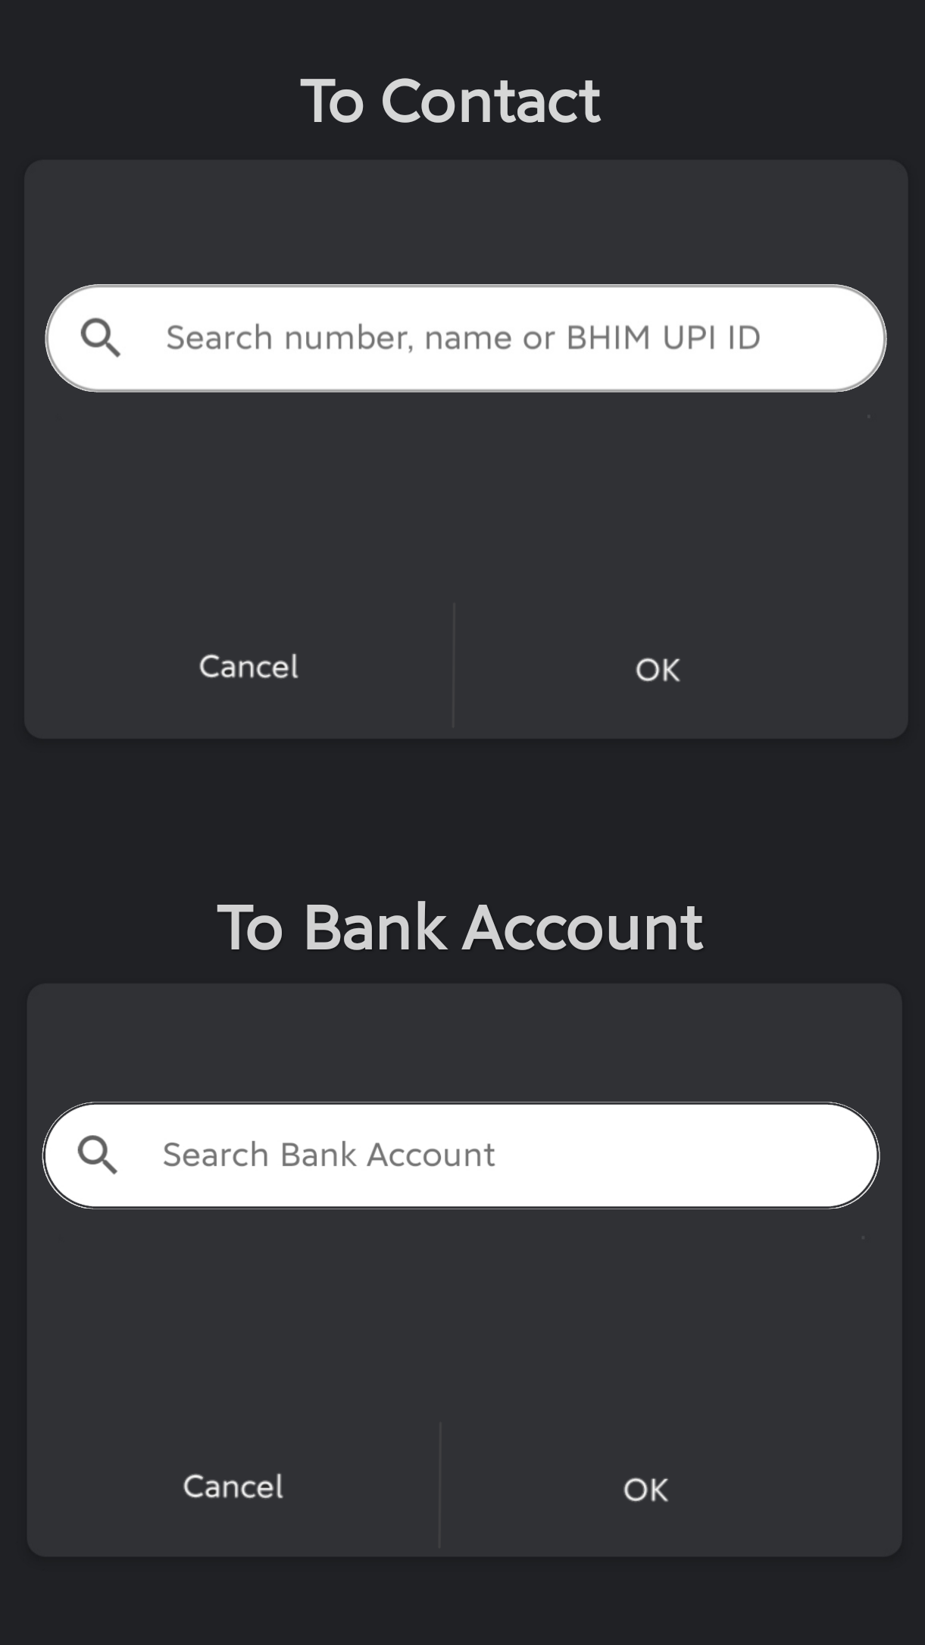
Lets see ON TIME for phone pay

Slide 7
To know
SMS has the option to schedule the time before sending.
Some websites ask you to schedule things earlier....but they will be just 1 / 2 apps at the max which the website allows.
E mails have the option called scheduled timing.. But then it's only the mails separately.
Through this app, all the social media would be under one roof, and all the platforms can be accessed in one go.
ON-TIME is not about setting a reminder, but actually automating the whole process by itself.

Slide 8
Future developments
Introduce voice assistant on further development.
Similar apps which may get created in future too will get included in our app.

Slide 9
Installations:
ANDROID STUDIO
FIREBASE – For backend
UIAUTOMATOR- Class and Activities.
THANK YOU

